Slide 1
Command Line Interface

Slide 2
Command Line Interfaces
Before Windows and other Graphical User Interfaces existed, everything on a typical Personal Computer was controlled using the keyboard.
A Command Line Interface (CLI) enabled the user to type commands into the 'command line'. It is basically a text version of the modern Graphic User Interface.
The Disk Operating System (DOS) was the standard for IBM and IBM compatible PCs. MS-DOS, created by Microsoft, was commonly used.

Slide 3
Command Line Interface – "Shell"
Also known as a 'shell', the CLI provides access to basic and administration functionality.
Windows/PC has the Command Shell (or Command Prompt) and PowerShell (introduced in 2006)
Linux has BASH: Bourne Again Shell
  Based on the original Bourne Shell created in 1979.
Over the years, dozens of different shells have been created to work with different operating systems, and to meet a different set of requirements.

Slide 4
Command Line Interfaces
Before Windows, MS-DOS was the standard OS and the CLI was how PCs were used.
Only one program ran at a time, launched by typing its name into the CLI
All DOS programs end with 3 letter file ‘extensions’:
  .exe – signifies an executable program that is formatted for a particular OS and CPU architecture
  .com – also an executable file, but simpler and limited to 64KB in size
  .bat – a ‘batch file’ containing a sequence of commands that run in sequence in Command Prompt. The ‘.cmd’ extension was added in 1993.

Slide 5
The Early Days
Very early computer programs were mainly used to perform calculations
Input data would be fed into the program
A set of mathematical operations were then performed on the data in sequence
Programs did not accept user input or allow changes one they started running
An example of this is calculating a company's weekly paychecks

Slide 6
Commands
Commands allow users to perform various tasks, such as copying, deleting, or moving files, and managing programs.
Commands fall into three categories:
  File Management: create, delete, or copy files; navigation through directories
  System Configuration: changing system settings, managing drives, and analyzing/fixing hardware issues
  Program Execution: run programs and scripts, without needing a graphical interface.
This will be an introduction to scripting in the Windows Command Shell

Slide 7

Windows Command Prompt
Cmd.exe is a program that is launched to open the 'command prompt'.
If you press the Windows key and then type ‘cmd’ and press enter, a new command prompt window will open
You’re then able to type in shell commands and run programs

Slide 8
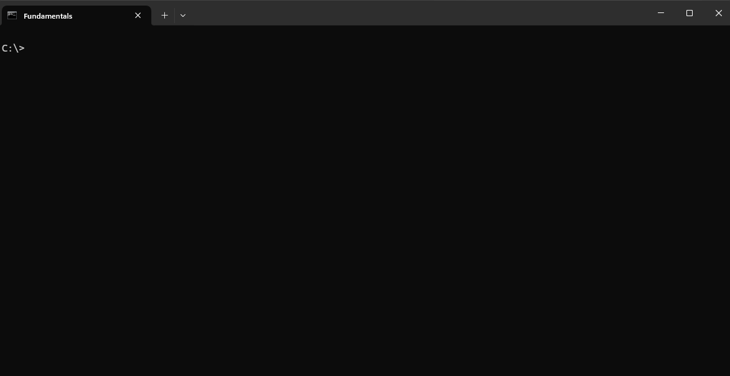
Using the Command Prompt
Type in a command and press enter
Capitalisation doesn’t matter
Type ‘help’ to get a list of commands
What now?

Slide 9
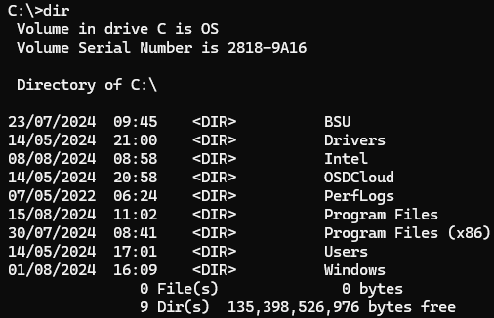
Command shell examples: dir
dir = directory listing

Slide 10
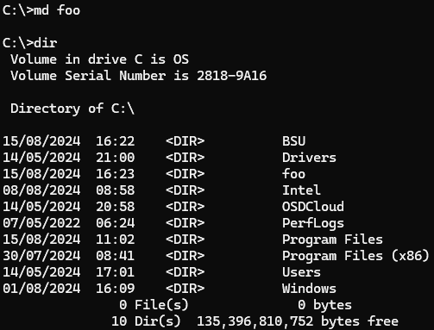
Command shell examples: md
md = make a directory
or use ‘mkdir’

Slide 11
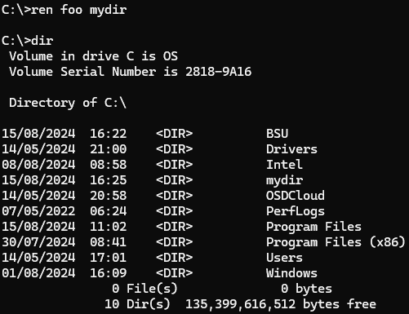
Command shell examples: ren
ren = rename a file or directory
Or use ‘rename’

Slide 12
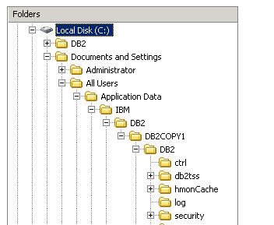
Drives and Directories
Storage drives are identified by letters, A – Z and always followed by ‘:’ the colon symbol
Historically A: and B: were used for floppy disk drives, and C: was for internal storage – where the OS is loaded from.
Drives and directories form a 'tree' structure
All files are 'in' a single directory

Slide 13
Drives and Directories
The Windows Command shell has the concept of a working location: the specific drive and directory combination the shell is focused on.
The starting location may differ based on how you opened the shell or other factors
When you open a Command Shell, this location is shown in the prompt, for example:
  C:\>
  C:\Users\Default>
  C:\Windows\System32>
This is called the 'current working directory' (CWD)

Slide 14
Commands and CWD
Most commands you type use the CWD unless you specify otherwise
dir will list the contents of the current directory
md will create a new directory within the current directory
Specifying a full directory path overrides this:
dir c:\ will list the contents of the drive c: root directory
md c:\test will create a new directory called test in c:\

Slide 15
Command parameters
Type help to get a listing of all commands
Note that some commands require administrator rights
  They may be unsafe to run unless you know what you’re doing!
Some commands accept (or require) additional parameters:
  FOO is the parameter used with md to create the directory FOO
  ren requires 2 parameters for the old name and the new name
Type help <command> for details on a specific command:
  help dir

Slide 16
Command ‘switches’
Some commands also accept ‘switches’ to set various options
For example, the dir command allows you to specify which items to list, and formatting options:
  Typing dir /b will list on file and directory names
  Typing dir /ad will list only directories
  Typing dir /p will pause after each screenful of information
The copy command allows you to specify information about the files and when/how to copy
  Typing copy FILE1 FILE2 /y will automatically assume ‘yes’ instead of asking if you want to overwrite FILE2, if it already exists

Slide 17
Powerful Commands
The combination of parameters, switches and options allow you to precisely specify the behaviour you want:
fc /A /C project.py project_backup.py
The fc compares two files. It can compare text or binary files
Use the fc command to compare the file 'project.py' to the file 'project_backup.py' .
  /a = display only the first an last lines of differences
  /c = case insensitive comparison

Slide 18
Powerful Commands
The combination of parameters, switches and options allow you to precisely specify the behaviour you want:
xcopy *.dll /r /k /d d:\project\runtime
The xcopy command is a more powerful version of copy; capable of copying files in subdirectories and using a combination of flags
Use the xcopy command to copy files from the current directory to the directory 'd:\project\runtime' .
  /r = overwrite files already in the destination, and
  /k = Keep file attributes (read-only, modification date & time)
  /d = copy only files that are newer than those in the destination
This level of control is critical for automating tasks

Slide 19
Running Programs
In addition to the commands built into the Command shell, programs present on the computer can be launched also.
The Windows\System32 directory contains a number of programs used for system management
whoami.exe displays the username of the current user:
  C:\> whoami /UPN
  academic\tutor1
whoami can be passed parameter to display additional information, such as:
  /priv = display security privileges of the current user
  /upn = display use name in User Principal Format

Slide 20
Requirements come first
The Command Line Interface / shell is still a very useful solution for many problems, even with sophisticated graphical interfaces
Why?
  Administrative tasks often don't need a GUI
  GUI interfaces require extra processing time for the graphics
  A sequence of tasks can be completed more efficiently using commands. Clicking can be slow…
  Automation!
As with most computing solutions, the key is to first understand the problem and what the solution must achieve.

Slide 21
Using the CLI

Slide 22
The CLI
The CLI is the interface in users can type commands for the computer to process.
The command line is one of the most useful and efficient tools we have as developers
But it's not exactly user friendly … it can be overwhelming and complex at first
It's actually easy to perform simple tasks – and then build more skill with practice

Slide 23
Windows Command Prompt
Press the Windows key and then type ‘cmd’ and press enter, a new command prompt window will open
You’re then able to type in shell commands and run programs, such as:
  cls – clear the screen
  help – list all built-in commands
  color – change the foreground and background colour (try "F0")
  start – start a program in a new window (try "start notepad")
  ver – display the running version of Windows

Slide 24

System Administration
Many of the commands available through the CLI will be unavailable to you – especially on university PCs
Commands that can change how the system is configured are only available to Admin users
It is possible that you may be able to delete system files or otherwise make a computer unusable.
Please be responsible! Research exactly what a command does before you try it!

Slide 25
File Commands
Many commands work on files:
dir – list files and directories
copy – copy files
move – move files from one directory to another
del – delete files
You can also create a new file just by typing:
"copy con" will take what you type into the console and stored it in a new file:
  C:> copy con foo.txt
  Hello!
  ^Z
That's a Control-Z

Slide 26
Wildcards
In many cases, you will want to perform the same operation on multiple files:
  copy file1.txt .\files
  copy file2.txt .\files
  etc.
If there are 100 files to copy, this will be painful
Wildcards allow you to use the ‘*’ and ‘?’ symbols to specify filename patterns. The shell will then run the operation on all files that match the pattern.

Slide 27
Wildcards
Flexibly match names of multiple files
? is interpreted to mean “0 or 1 symbol”
copy file?.txt .\files
Copy all files with a name that starts with ‘file’ that have exactly zero or one symbol before ’.txt’.
  File.txt will be copied
  File1.txt will be copied
  FileK.txt will be copied
  File11.txt will not be copied
  The files will be copied to a directory called 'files'

Slide 28
Wildcards
Flexibly match names of multiple files
* is interpreted to mean “0 or more symbols”
copy file*.txt .\files
Copy all files with a name that starts with ‘file’ – with any number of additional symbols appearing before ’.txt’.
  File.txt will be copied
  File1.txt will be copied
  File_Hello2025.txt will be copied
  File11.txt will be copied
  The files will be copied to a directory called 'files'

Slide 29
Environment Variables
Every Windows PC has "environment variables" that are initialised when starting up. These help applications with routine operations.
One of the most important of these is PATH.
The PATH variable contains all the directories that the OS will check when trying to run a program, separated by semicolons:
Type "path" at the command line to see the value of the path variable
PATH=C:\Windows\system32;C:\Windows;C:\Windows\System32\Wbem;C:\Windows\System32\WindowsPowerShell\v1.0\;C:\Windows\System32\OpenSSH\;C:\Program Files\Microsoft VS Code\bin;C:\Program Files\nodejs\;

Slide 30
Python Commands
You can run Python programs from the Command Line as well as within the Python Interpreter.
At the command prompt type "python" followed by the name of the python file to run.
C:\> python my_program.py
This will launch the interpreter, run the file "my_program.py" and then close the interpreter

Slide 31
Python Executable Files
You can also make a Python program into a self-contained application that doesn't need Python to run!
PyInstaller works on Python 3.8 and newer, and on Windows, MacOS and Linux.
At the command prompt run PIP to install PyInstaller
C:\> pip install -U pyinstaller
And then in the directory where you Python program .py file located, run PyInstaller:
C:\> pyinstaller my_program.py
This will create a new executable program called "my_program.exe" in directory call 'dist'.
PyInstaller Manual — PyInstaller 6.11.0 documentation

Slide 32
What do you need to do?
Commands in the CLI can help with useful tasks.
But what are those tasks? Examples include:
  Copy all your code files into a backup directory
  Delete temporary files to clear space
  Rename multiple files at the same time
  Interact with Git or other version control system
  Etc
Next week you start scripting in the CLI

